Slide 1
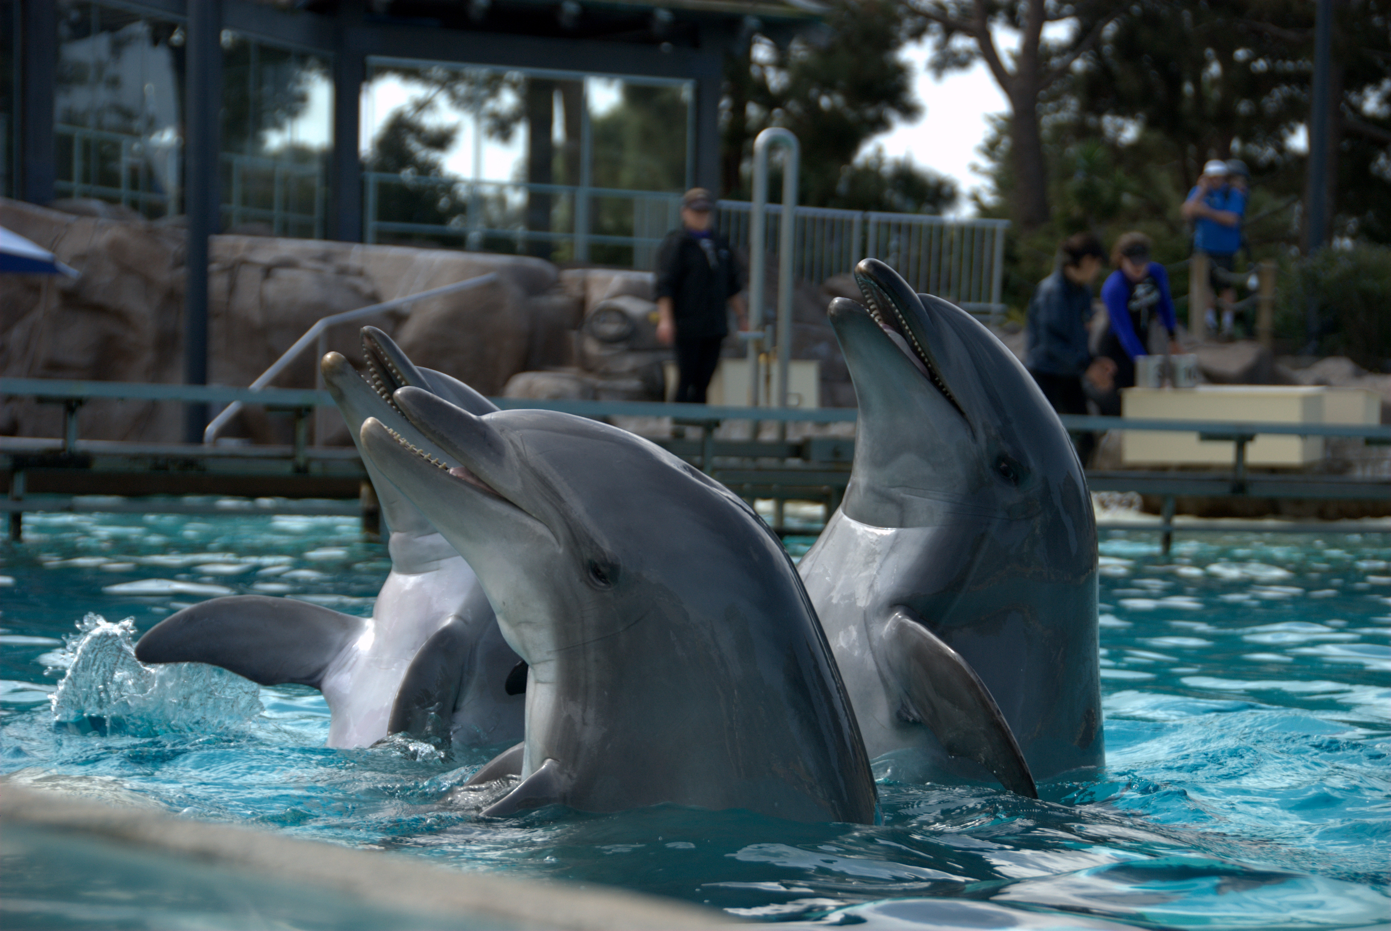
Lessons from building a startup foundation team
Vinayak Hegde
Independent Consultant
@vinayakh

Slide 2
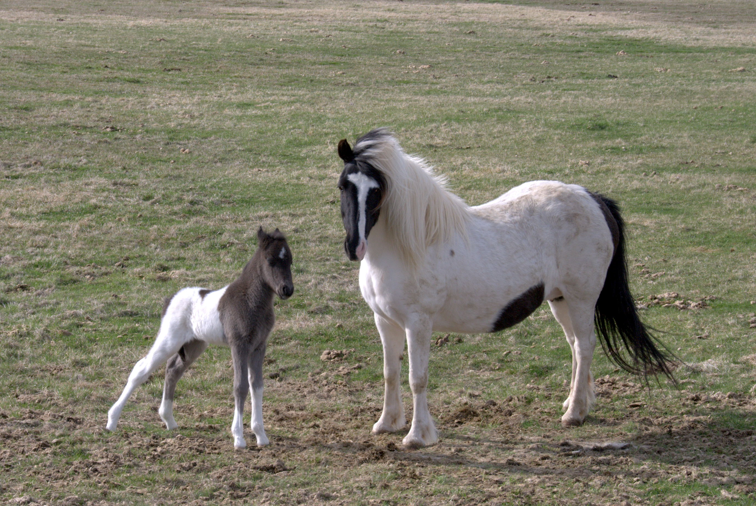
Play in two acts
Act 1
  Experiences and advice as a startup employee
Act 2
  Experiences from building startup teams

Slide 3

So you want to be a
startup employee ?

Slide 4

What do I do ?
Look to constantly learn
Look to contribute to different areas
  Help is needed everywhere Always !!
Be comfortable with chaos
Understand the business
Take ownership & don't wait for instructions

Slide 5

Adjust your attitude
Disagree but commit
  People around you are headstrong and will have strong opinions. Deal with it.
Be ready to put in extra hours
Don't say it's not my job.
Aim to maximise learning and not salary / benefits
Fasten your seatbelts - get ready for the emotional rollercoaster

Slide 6

Where do I stand ?
Understand ESOPs and maximise risks earlier in career (especially if you have an option)
As the startup grows, roles will evolve and you will have choices
  Choose wisely - do what you love rather than chasing status
The dilemma of a growing startup employee
  Should I speci alise ?
  Should I generalise ?

Slide 7

So you want to build a
startup team ?

Slide 8

Startup as a community
A startup is made of people & not product & not technology
Think of your startup as a community and your customers as extended part of that community
Mentor your employees and give them freedom to explore
Trust them (It will work wonders)
Spend time and effort to grow them

Slide 9

On Hiring
Hire from 2nd & 3rd Tier colleges as well
  More loyal, hardworking people
Hire for attitude and train for skills
Encourage diversity in opinion and beware of monoculture
Early employee are your greatest asset as they set your culture
Link compensation to impact & contribution and not to experience/skillset

Slide 10

Steer them and be steered
Encourage people to work on different areas
  Develops understanding of roles & empathy for colleagues
Set clear goals and make people accountable
  Make them visible to everyone
Good ideas can come from anywhere especially in a market-discovery phase

Slide 11

ESOPs in 5 minutes
Types of stock
  Preferred stock
  Common stock
Pricing & Taxes
  Strike/Grant price & Exercise prices
  Tax implications
Vesting schedule
  Grant date
  Vesting date
  Exercise date

Slide 12

Thank you
Twitter : @vinayakh
Email : vinayakh@gmail.com
All photos from my flickr

